Slide 1

YAY! - Celebrating Education

Slide 2
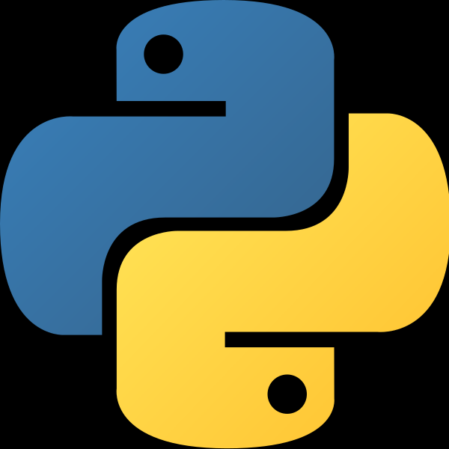

Python Course
(Basics)

Slide 3
Difference between ‘==‘ and ‘is’ operator, Functions in Python

Slide 4
Course Agenda for Today
Difference between == and is operator
What does the if __name__ == “__main__”: do?
What is Python Main Function?
Functions

Slide 5
Difference between == and is operator
The Equality operator (==) compares the values of both the operands and checks for value equality. Whereas the ‘is’ operator checks whether both the operands refer to the same object or not.
# Python program to
# illustrate the
# difference between
# == and is operator
# [] is an empty list
list1 = []
list2 = []
list3=list1
if (list1 == list2):
print("True")
else:
print("False")
if (list1 is list2):
print("True")
else:
print("False")

Slide 6
What does the if __name__ == “__main__”: do?
A Python module is a file that has a .py extension. All we need to do is create a file that contains legitimate Python code and give the file a name with .py extension. A module can be imported to other modules or run directly via command line.
The __name__ is a special built-in variable which evaluates to the name of the current module. However, if a module is being run directly (from command line), then __name__ instead is set to the string “__main__”.
Before executing code, Python interpreter reads source file and define few special variables/global variables.
If the python interpreter is running that module (the source file) as the main program, it sets the special __name__ variable to have a value “__main__”. If this file is being imported from another module, __name__ will be set to the module’s name.

Slide 7
What is Python Main Function?
Python main function is a starting point of any program. When the program is run, the python interpreter runs the code sequentially. Main function is executed only when it is run as a Python program. It will not run the main function if it imported as a module.
It is important that after defining the main function, you call the code by if__name__== "__main__" and then run the code, only then you will get the output.
Def keyword
The def keyword is used to create, (or define) a function.
def main():
print("Hello from a function")
If __name__==“__main__”:
main()

Slide 8
Functions
In Python, a function is a group of related statements that performs a specific task.
Functions help break our program into smaller and modular chunks. As our program grows larger and larger, functions make it more organized and manageable.
Furthermore, it avoids repetition and makes the code reusable.
A function is a block of code which only runs when it is called.
You can pass data, known as parameters, into a function.
A function can return data as a result.
# Python program to execute
# function directly
def my_function():
print ("I am inside function")
# We can test function by calling it.
my_function()

Slide 9
The pass Statement
Function definitions cannot be empty, but if you for some reason have a function definition with no content, put in the pass statement to avoid getting an error.
The return statement
The return statement is used to exit a function and go back to the place from where it was called.
def absolute_value(num):
"""This function returns the absolute
value of the entered number"""
if num >= 0:
return num
else:
return -num
print(absolute_value(2))

Slide 10
Functions- Hands-on Problem 1
WAP with Function fizz_buzz where there'll be a single argument [Number].
Rules for Output :
1. If the number is divisible by 3: print out 'Fizz' [3,6,9 etc]
2. If the number is divisible by 5: print out 'Buzz' [5,15,20 etc]
3. If the number is divisible by both 3 and 5: print out 'FizzBuzz' [15,30 etc]
4. If None of them is satisfied, then print the number itself. [2,4,7 etc]

Slide 11
Functions- Hands-on Problem 2
WAP to find out Days of a Month using function which will take in two arguments : year, month number.
days_in_month(2017, 8) -> Find the Number of Days in August[8th Month of the Year] in Year 2017 == 31
days_in_month(2020, 2) -> Find the Number of Days in February[2nd Month of the Year] in Year 2020 == 29

Slide 12
Thank You!
See you in the next class!

